Slide 1
Indexing and Hashing
Chapter - 12

Slide 2
Basic Concept
100B
R1
R100
R101
R200
R201
R300
:
:
R1,00,000
Block 1
Search Key | Block Pointer
R1 | Block 1
R101 | Block 2
R201 | Block 3
R99897 | :
Block 2
Block 3
Index File
Access should be fast
Binary Search ?
Block 1000

Slide 3
Basic Concepts
Indexing mechanisms used to speed up access to desired data.
E.g., author catalog in library
Search Key - attribute to set of attributes used to look up records in a file.
An index file consists of records (called index entries) of the form
Index files are typically much smaller than the original file
Two basic kinds of indices:
Ordered indices: search keys are stored in sorted order
Hash indices: search keys are distributed uniformly across “buckets” using a “hash function”.
search-key
pointer

Slide 4
Index Evaluation Metrics
Access types supported efficiently. E.g.,
records with a specified value in the attribute
or records with an attribute value falling in a specified range of values.
Access time
Insertion time
Deletion time
Space overhead

Slide 5
Types of Indexing
Indexing techniques evaluated on basis of :-
In an ordered index, index entries are stored sorted on the search key value. E.g., author catalog in library.
Primary index:
in a sequentially ordered file, the index whose search key specifies the sequential order of the file.
Primary key is used as search key
Clustering index
Records must be in order
The search key of a primary index is usually but not necessarily the primary key.
Secondary index:
File is unsorted
Any key or non key attribute is used for indexing (non-clustering index)
Index file should always be sorted

Slide 6
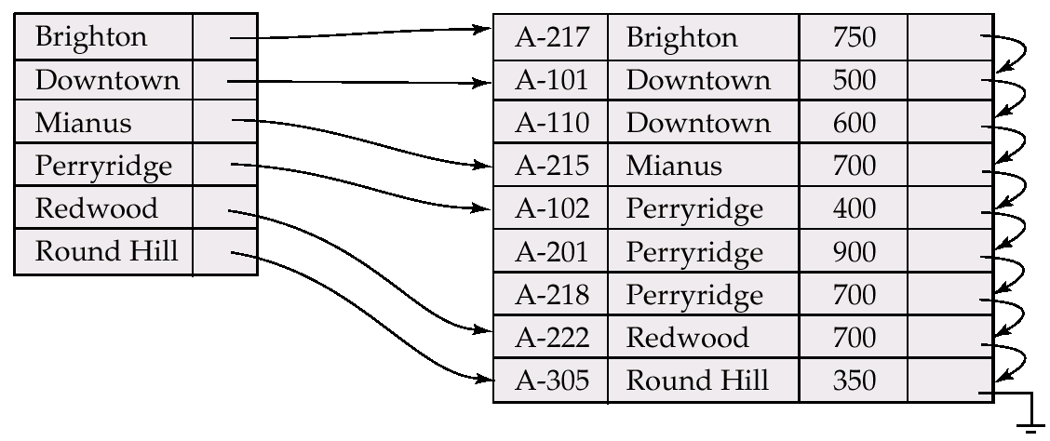
Dense Index Files
Dense index — Index record appears for every search-key value in the file.

Slide 7
Sparse Index
Sparse Index: contains index records for only some search-key values.
Applicable when records are sequentially ordered on search-key
To locate a record with search-key value K we:
Find index record with largest search-key value < K
Search file sequentially starting at the record to which the index record points
Less space and less maintenance overhead for insertions and deletions.
Generally slower than dense index for locating records.
Good tradeoff: sparse index with an index entry for every block in file, corresponding to least search-key value in the block.

Slide 8
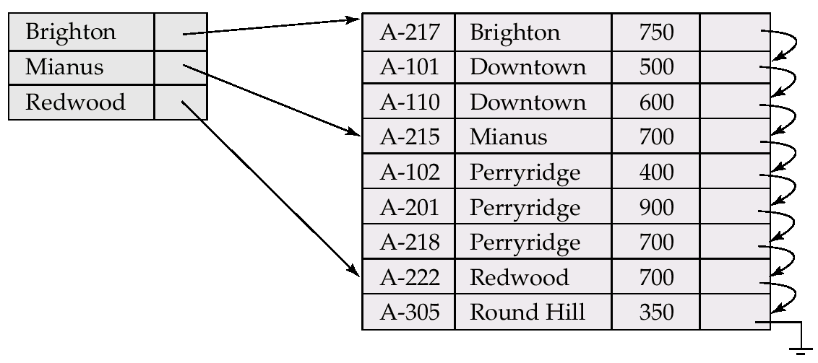
Sparse Index

Slide 9
Multilevel Index
If primary index does not fit in memory, access becomes expensive.
To reduce number of disk accesses to index records, treat primary index kept on disk as a sequential file and construct a sparse index on it.
outer index – a sparse index of primary index
inner index – the primary index file
If even outer index is too large to fit in main memory, yet another level of index can be created, and so on.
Indices at all levels must be updated on insertion or deletion from the file.

Slide 10
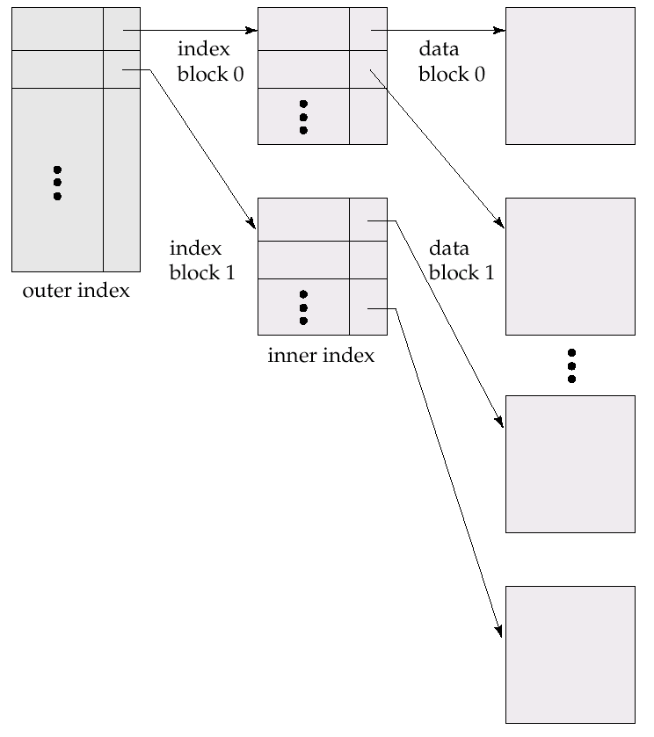
Multilevel Index

Slide 11
Index Update: Deletion
If deleted record was the only record in the file with its particular search-key value, the search-key is deleted from the index also.
Single-level index deletion:
Dense indices – deletion of search-key is similar to file record deletion.
Sparse indices – if an entry for the search key exists in the index, it is deleted by replacing the entry in the index with the next search-key value in the file (in search-key order). If the next search-key value already has an index entry, the entry is deleted instead of being replaced.

Slide 12
Index Update: Insertion
Single-level index insertion:
Perform a lookup using the search-key value appearing in the record to be inserted.
Dense indices – if the search-key value does not appear in the index, insert it.
Sparse indices – if index stores an entry for each block of the file, no change needs to be made to the index unless a new block is created. In this case, the first search-key value appearing in the new block is inserted into the index.
Multilevel insertion (as well as deletion) algorithms are simple extensions of the single-level algorithms

Slide 13
Primary Indexing
Main file should be sorted
Primary key should be used as anchor attribute / search attribute
Example of sparse indexing
No. of entries in index file = No. of blocks acquired by the main file
No. of block access required = log₂ n + 1
Anchor Attribute
PK | Name | Age
1
2
:
5
100
Search Key | Block Pointer
1 | Block 1
6 | Block 2
10 | :
: | :
Block 1
Block 2
Index File

Slide 14
Primary Indexing
Block Size = 1024 B, No of records = 30000
Record Size = 100B(Main file) = 15B (Index file)
Blocking Factor = Block Size / record size = 10.24 ~=10
No. of blocks for main file = no. of records in main file / blocking factor
= 30000 / 10 = 3000
No. of block access required = log₂ n = log₂ 3000 = 11.45 = 12
With Primary Index:
Blocking Factor = ?
No. of blocks for index file =?
No. of block access required = ?

Slide 15
Primary Indexing
Block Size = 1024 B No of records = 30000
Record Size = 100B(Main file) = 15B (Index file)
Blocking Factor = Block Size / record size = 10.24 ~=10
No. of blocks for main file = no. of records in main file / blocking factor
= 30000 / 10 = 3000
No. of block access required = log₂ n = log₂ 3000 = 11.45 = 12
With Primary Index:
Blocking Factor = 1024 / 15 ~= 68
No. of blocks for index file = 3000 / 68 ~=44.7 = 45
No. of block access required = log₂ n + 1 = log₂ 45 +1 ~=6+1 = 7

Slide 16
Clustered Indexing
Main file should be sorted
Non key attribute can be used as anchor attribute / search attribute
There will be one entry for each unique value of non key attribute
No. of entries in index file = ? Example of sparse or dense = ?
No. of block access required >= log₂ n + 1, if no. of block acquired by index file is n.
NK | Name | Age
1
1
2
2
3
3
:
3
4
Anchor Attribute
Search Key | Block Pointer
1 | Block 1
2 | Block 1
3 | Block 1
4 | Block 3
: | :
: | :
Block 1
Block 101
Block 2
Index File
Block 3

Slide 17
Secondary Indexing
Main file is unsorted
Key or Non key attribute can be used as anchor attribute / search attribute
There will be one entry for each unique value of non key attribute
Example of dense indexing
No. of block access required >= log₂ n + 1, if no. of block acquired by index file is n.
NK | Name | Age
1
3
2
20
15
13
:
5
4
Anchor Attribute
Search Key | Block Pointer
1 | Block 1
2 | Block 1
3 | Block 1
4 | Block 3
: | :
: | :
Block 1
Block 101
Block 2
Index File
Block 3

Slide 18
Secondary Indexing
Block Size = 1024 B, No of records = 30,000
Record Size = 100B(Main file) = 15B (Index file)
Blocking Factor = ⌊Block Size / record size ⌋ = 10.24 ~=10
No. of blocks for main file = ⌈no. of records in main file / blocking factor ⌉
= ⌈ 30000 / 10 ⌉ = 3000
No. of block access required = n = 3000
With Secondary Index:
Blocking Factor = ?
No. of blocks for index file =?
No. of block access required = ?

Slide 19
Secondary Indexing
Block Size = 1024 B, No of records = 30,000
Record Size = 100B(Main file) = 15B (Index file)
Blocking Factor = ⌊Block Size / record size ⌋ = 10.24 ~=10
No. of blocks for main file = ⌈no. of records in main file / blocking factor ⌉
= ⌈ 30000 / 10 ⌉ = 3000
No. of block access required = n = 3000
With Secondary Index:
Blocking Factor = ⌊Block Size / record size ⌋ = ⌊1024 / 15⌋ =68
No. of blocks for index file = ⌈ 30000 / 68 ⌉ = 442
No. of block access required = ⌈ log₂ n + 1 ⌉ = ⌈ log₂ 442 + 1 ⌉ ~ = 9+1 =10

Slide 20
B⁺-Tree Index Files
.
B⁺-tree indices are an alternative to indexed-sequential files
Disadvantage of indexed-sequential files:
performance degrades as file grows, since many overflow blocks get created.
Periodic reorganization of entire file is required.
Advantage of B⁺-tree index files:
automatically reorganizes itself with small, local changes, in the face of insertions and deletions.
Reorganization of entire file is not required to maintain performance.
Disadvantage of B⁺-trees:
extra insertion and deletion overhead, space overhead.
Advantages of B⁺-trees:
outweigh disadvantages, and they are used extensively.

Slide 21
B⁺-Tree Index Files
A B⁺-tree is a rooted tree satisfying the following properties:
All paths from root to leaf are of the same length
Each node that is not a root or a leaf has between [n/2] and n children.
A leaf node has between [(n–1)/2] and n–1 values
Special cases:
If the root is not a leaf, it has at least 2 children.
If the root is a leaf (that is, there are no other nodes in the tree), it can have between 0 and (n–1) values.

Slide 22
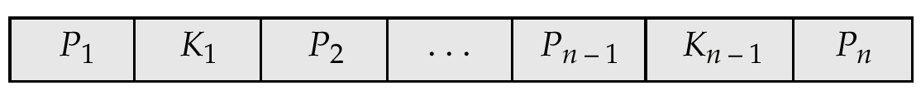
B⁺-Tree Node Structure
Typical node
K_{i} are the search-key values
P_{i} are pointers to children (for non-leaf nodes) or pointers to records or buckets of records (for leaf nodes).
The search-keys in a node are ordered
K₁ < K₂ < K₃ < . . . < K_{n–1}

Slide 23
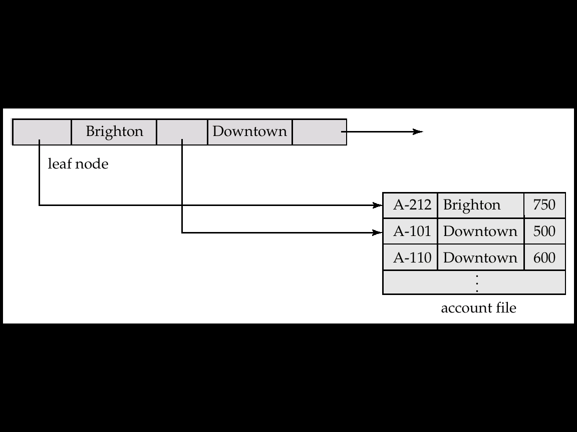
Leaf Nodes in B⁺-Trees
Properties of a leaf node:
For i = 1, 2, . . ., n–1, pointer P_{i} either points to a file record with search-key value K_{i}, or to a bucket of pointers to file records, each record having search-key value K_{i}. Only need bucket structure if search-key does not form a primary key.
If L_{i}, L_{j} are leaf nodes and i < j, L_{i}’s search-key values are less than L_{j}’s search-key values
P_{n} points to next leaf node in search-key order

Slide 24
Example
Insert 2,4,6,7
k
 | 3 |  | 5
Internal node
Leaf nodes
 | 2
 | 3 |  | 4
 | 5 |  | 6 |  | 7
x < k
x >= k

Slide 25
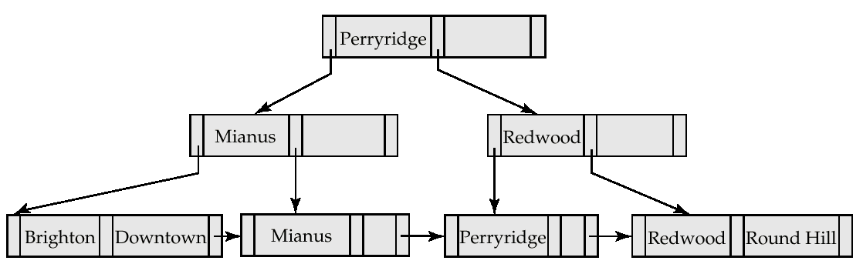
Example of a B⁺-tree
B⁺-tree for account file (n = 3)

Slide 26
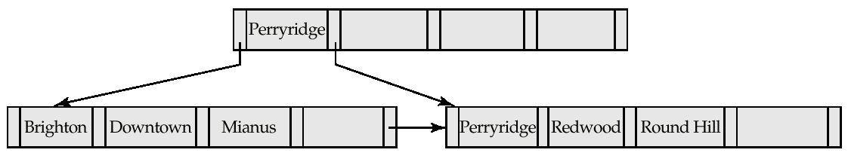
Example of B⁺-tree
B⁺-tree for account file (n = 5)
Leaf nodes must have between 2 and 4 values (⎡(n–1)/2⎤ and n –1, with n = 5).
Non-leaf nodes other than root must have between 3 and 5 children (⎡(n/2⎤ and n with n =5).
Root must have at least 2 children.

Slide 27
Example
Construct B+ tree for following data {2,4,7,10,17,21,28} of order 4
 | 2 |  | 4 |  | 7
 | 4
 | 2
 | 4 |  | 7 |  | 10

Slide 28
Example
Construct B+ tree for following data {2,4,7,10,17,21,28} of order 4
 | 2 |  | 4 |  | 7
 | 4 |  | 7
 | 2
 | 4
 | 7 |  | 10

Slide 29
Example
Construct B+ tree for following data {2,4,7,10,17,21,28} of order 4
 | 2 |  | 4 |  | 7
 | 4 |  | 7
 | 2
 | 4
 | 7 |  | 10 |  | 17

Slide 30
Example
Construct B+ tree for following data {2,4,7,10,17,21,28} of order 4
 | 2 |  | 4 |  | 7
 | 4 |  | 7
 | 2
 | 4
 | 7 |  | 10 |  | 17

Slide 31
Example
Construct B+ tree for following data {2,4,7,10,17,21,28} of order 4
 | 2 |  | 4 |  | 7
 | 4 |  | 7 |  | 10
 | 10 |  | 17 |  | 21
 | 2
 | 4
 | 7

Slide 32
Example
Construct B+ tree for following data
{2,4,7,10,17,21,28}
 | 7
 | 4
 | 10 |  | 17
 | 2
 | 4
 | 7
 | 10
 | 17 |  | 21 |  | 28

Slide 33
Question
Insert the following elements {5,10,12,13,14,1,2,3,4} into a empty B+ tree of order = 3

Slide 34
B+ Tree
Construct B+ tree for following data {10,3,6,8,4,2,1} of order 3
 | 3 |  | 10
 | 6
 | 3
 | 6 |  | 10
8

Slide 35
B+ Tree
Construct B+ tree for following data {10,3,6,8,4,2,1} of order 3
 | 3 |  | 10
 | 6 |  | 8
 | 3
 | 6
 | 8 |  | 10

Slide 36
B+ Tree
Construct B+ tree for following data {10,3,6,8,4,2,1} of order 3
6
3
 | 6 |  | 8
 | 3 |  | 4
 | 6
 | 8 |  | 10
2

Slide 37
B+ Tree
Construct B+ tree for following data {10,3,6,8,4,2,1} of order 3
 | 6
 | 3
 | 8
 | 2
 | 3 |  | 4
 | 6
 | 8 |  | 10

Slide 38
B+ Tree
Construct B+ tree for following data {10,3,6,8,4,2,1} of order 3
 | 6
 | 3
 | 8
 | 1 |  | 2
 | 3 |  | 4
 | 6
 | 8 |  | 10

Slide 39
Deleting a node in B+ Tree
Delete node 8
 | 6
 | 3
 | 8
 | 1 |  | 2
 | 3 |  | 4
 | 6
 | 8 |  | 10

Slide 40
Deleting a node in B+ Tree
Delete node 8
 | 6
 | 3
 | 8
 | 1 |  | 2
 | 3 |  | 4
 | 6
 | 10

Slide 41
Deleting a node in B+ Tree
Delete node 8
 | 3 |  | 6
 | 1 |  | 2
 | 3 |  | 4
 | 6 |  | 10

Slide 42
Deleting a node in B+ Tree
Delete node 6
 | 6
 | 3
 | 8
 | 1 |  | 2
 | 3 |  | 4
 | 6
 | 8 |  | 10

Slide 43
Deleting a node in B+ Tree
Delete node 8
 | 3 |  | 8
 | 1 |  | 2
 | 3 |  | 4
 | 8 |  | 10

Slide 44
Question
Construct B+ tree for elements :- 1,4,7,10,17,19,20,21,25,28,31,42 of order 3
Delete node 20 from tree.
Gate Question
The following key values are inserted into B+ tree of order 3, where B+ tree is initially empty and the key values are:- 10,3,6,84,2,1
The minimum number of times leaf nodes would get split up as a result of these insertions is
a) 2 b) 3 c) 4 d) 5

Slide 45
Gate Question
With reference to the B+ tree index shown below, the minimum no. of nodes (including root node) that must be fetched in order to satisfy the following query: “Get all records with a search key greater than or equal to 7 and less than 15” is _______
5
 | 9
 | 5
 | 13 |  | 17
 | 1 |  | 3
 | 5 |  | 7
 | 9 |  | 11
 | 13 |  | 15
 | 17

Slide 46
Observations about B⁺-trees
Since the inter-node connections are done by pointers, “logically” close blocks need not be “physically” close.
The non-leaf levels of the B⁺-tree form a hierarchy of sparse indices.
The B⁺-tree contains a relatively small number of levels (logarithmic in the size of the main file), thus searches can be conducted efficiently.
Insertions and deletions to the main file can be handled efficiently, as the index can be restructured in logarithmic time

Slide 47
Searching in B⁺-Trees
Find all records with a search-key value of k.
Start with the root node
Examine the node for the smallest search-key value > k.
If such a value exists, assume it is K_{j}. Then follow P_{i} to the child node
Otherwise k ≥ K_{m–1}, where there are m pointers in the node. Then follow P_{m} to the child node.
If the node reached by following the pointer above is not a leaf node, repeat the above procedure on the node, and follow the corresponding pointer.
Eventually reach a leaf node. If for some i, key K_{i} = k follow pointer P_{i} to the desired record or bucket. Else no record with search-key value k exists.

Slide 48
Queries on B⁺⁻Trees
In processing a query, a path is traversed in the tree from the root to some leaf node.
If there are K search-key values in the file, the path is no longer than ⎡ log_{⎡n/2⎤}(K)⎤.
A node is generally the same size as a disk block, typically 4 kilobytes, and n is typically around 100 (40 bytes per index entry).
With 1 million search key values and n = 100, at most log₅₀(1,000,000) = 4 nodes are accessed in a lookup.
Contrast this with a balanced binary tree with 1 million search key values — around 20 nodes are accessed in a lookup
above difference is significant since every node access may need a disk I/O, costing around 20 milliseconds!

Slide 49
Updates on B⁺-Trees: Insertion
Find the leaf node in which the search-key value would appear
If the search-key value is already there in the leaf node, record is added to file and if necessary a pointer is inserted into the bucket.
If the search-key value is not there, then add the record to the main file and create a bucket if necessary. Then:
If there is room in the leaf node, insert (key-value, pointer) pair in the leaf node
Otherwise, split the node (along with the new (key-value, pointer) entry)

Slide 50
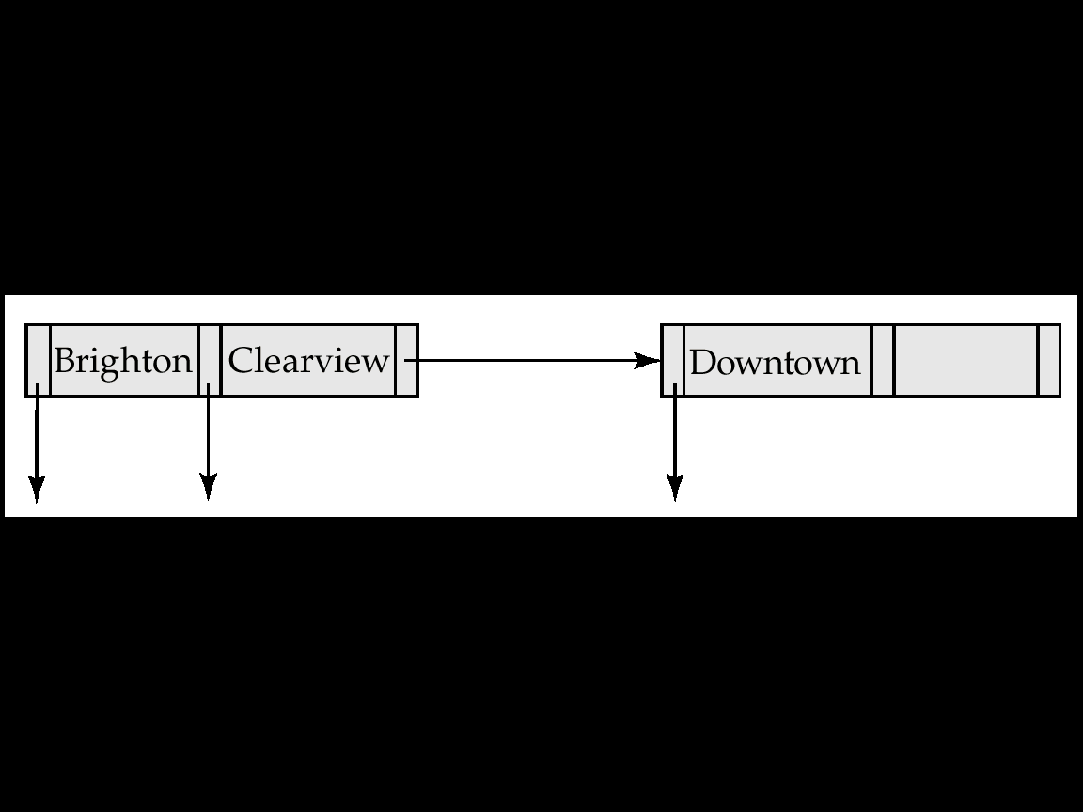
Updates on B⁺-Trees: Insertion
Splitting a node:
take the n(search-key value, pointer) pairs (including the one being inserted) in sorted order. Place the first ⎡ n/2 ⎤ in the original node, and the rest in a new node.
let the new node be p, and let k be the least key value in p. Insert (k,p) in the parent of the node being split. If the parent is full, split it and propagate the split further up.
The splitting of nodes proceeds upwards till a node that is not full is found. In the worst case the root node may be split increasing the height of the tree by 1.
Result of splitting node containing Brighton and Downtown on inserting clearview

Slide 51
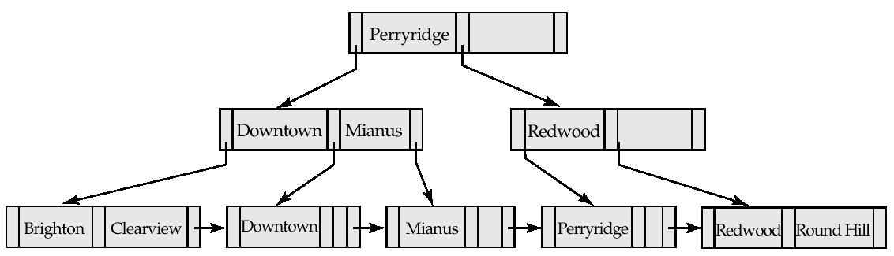
Updates on B⁺-Trees: Insertion
B⁺-Tree before and after insertion of “Clearview”

Slide 52
Updates on B⁺-Trees: Deletion
Find the record to be deleted, and remove it from the main file and from the bucket (if present)
Remove (search-key value, pointer) from the leaf node if there is no bucket or if the bucket has become empty
If the node has too few entries due to the removal, and the entries in the node and a sibling fit into a single node, then
Insert all the search-key values in the two nodes into a single node (the one on the left), and delete the other node.
Delete the pair (K_{i–1}, P_{i}), where P_{i} is the pointer to the deleted node, from its parent, recursively using the above procedure.

Slide 53
Updates on B⁺-Trees: Deletion
Otherwise, if the node has too few entries due to the removal, and the entries in the node and a sibling fit into a single node, then
Redistribute the pointers between the node and a sibling such that both have more than the minimum number of entries.
Update the corresponding search-key value in the parent of the node.
The node deletions may cascade upwards till a node which has ⎡n/2 ⎤ or more pointers is found. If the root node has only one pointer after deletion, it is deleted and the sole child becomes the root.

Slide 54
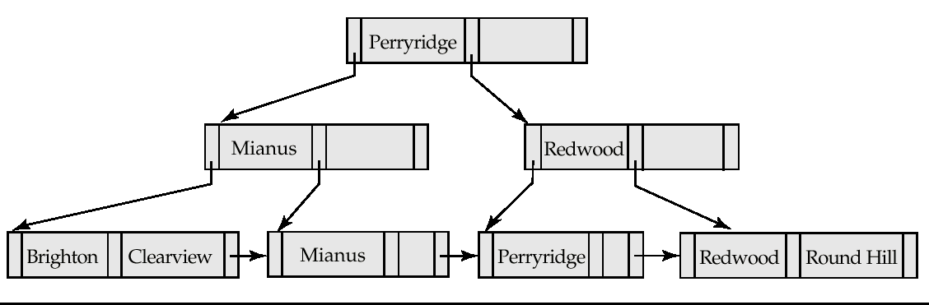
Examples of B⁺-Tree Deletion
Before and after deleting “Downtown”
The removal of the leaf node containing “Downtown” did not result in its parent having too little pointers. So the cascaded deletions stopped with the deleted leaf node’s parent.

Slide 55
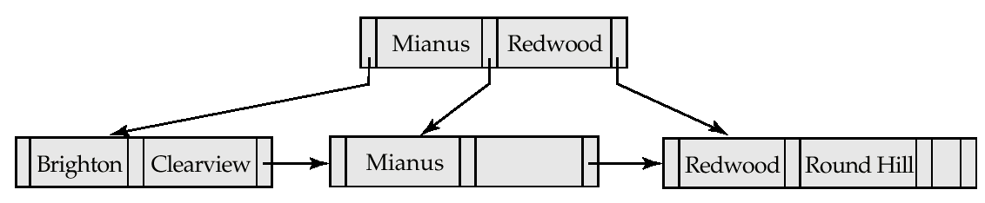
Examples of B⁺-Tree Deletion
Deletion of “Perryridge” from result of previous example
Node with “Perryridge” becomes underfull (actually empty, in this special case) and merged with its sibling.
As a result “Perryridge” node’s parent became underfull, and was merged with its sibling (and an entry was deleted from their parent)
Root node then had only one child, and was deleted and its child became the new root node

Slide 56
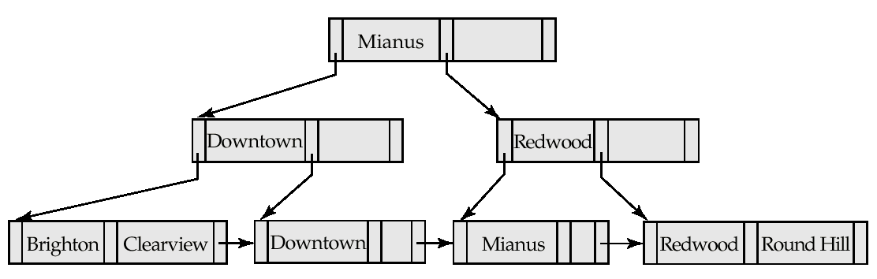
Example of B⁺-tree Deletion
Before and after deletion of “Perryridge” from earlier example
Parent of leaf containing Perryridge became underfull, and borrowed a pointer from its left sibling
Search-key value in the parent’s parent changes as a result

Slide 57
B⁺-Tree File Organization
Index file degradation problem is solved by using B⁺-Tree indices. Data file degradation problem is solved by using B⁺-Tree File Organization.
The leaf nodes in a B⁺-tree file organization store records, instead of pointers.
Since records are larger than pointers, the maximum number of records that can be stored in a leaf node is less than the number of pointers in a non leaf node.
Leaf nodes are still required to be half full.
Insertion and deletion are handled in the same way as insertion and deletion of entries in a B⁺-tree index.

Slide 58
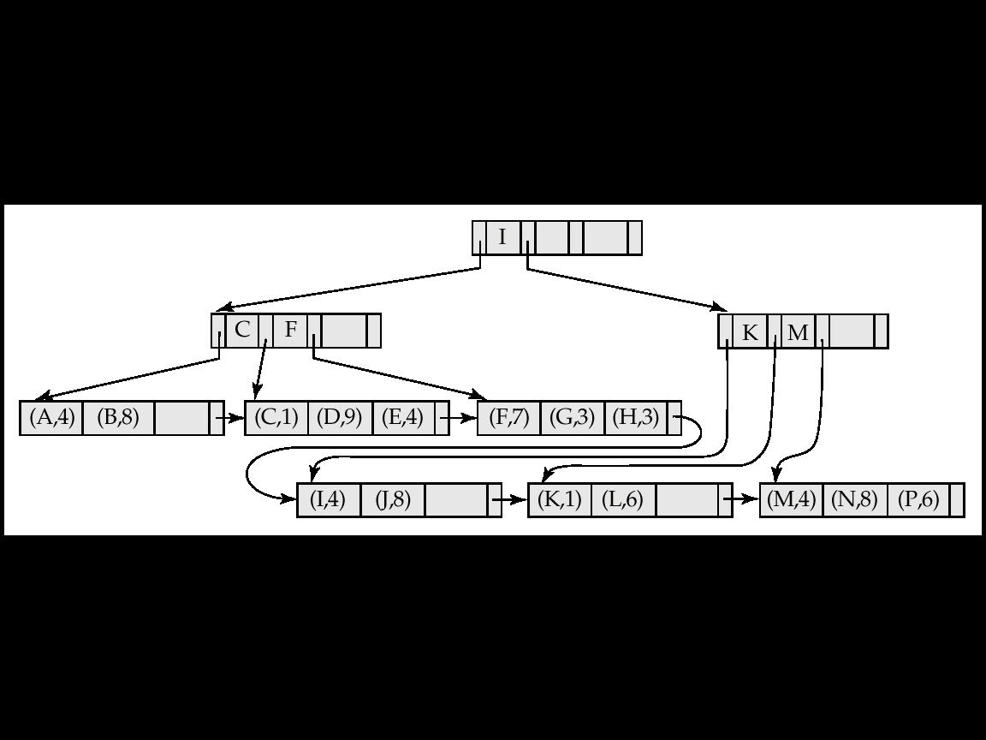
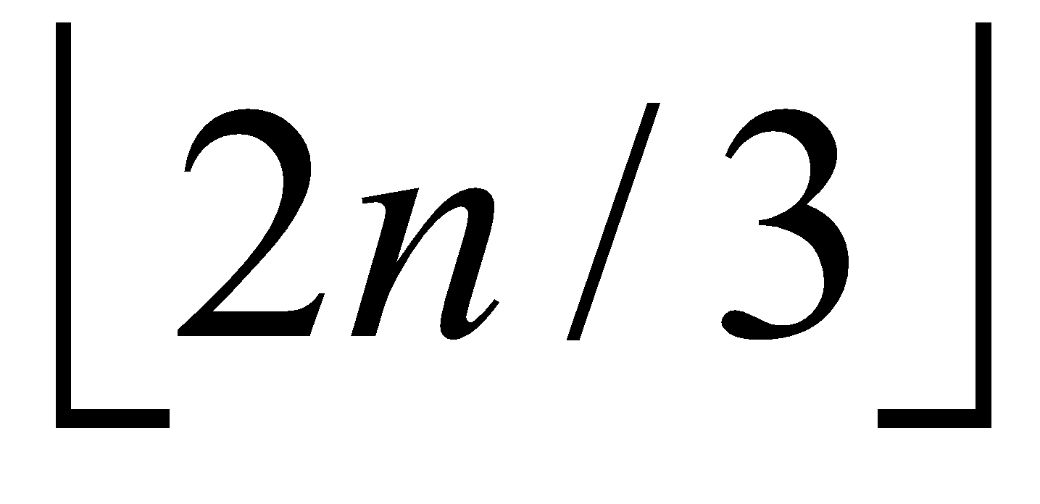
B⁺-Tree File Organization
Example of B⁺-tree File Organization
Good space utilization important since records use more space than pointers.
To improve space utilization, involve more sibling nodes in redistribution during splits and merges
Involving 2 siblings in redistribution (to avoid split / merge where possible) results in each node having at least entries

Slide 59
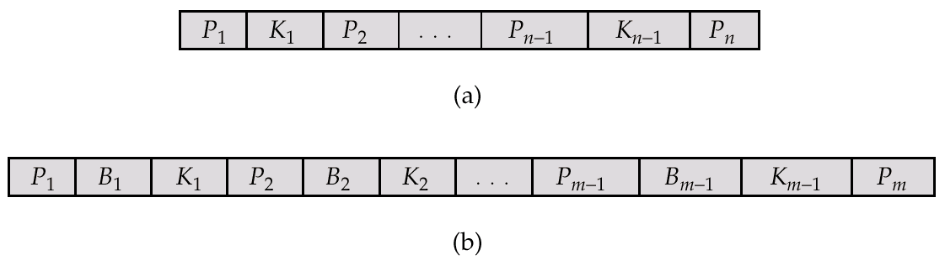
B-Tree Index Files
Similar to B+-tree, but B-tree allows search-key values to appear only once; eliminates redundant storage of search keys.
Search keys in non leaf nodes appear nowhere else in the B-tree; an additional pointer field for each search key in a non leaf node must be included.
Generalized B-tree leaf node
Non leaf node – pointers B_{i} are the bucket or file record pointers.

Slide 60
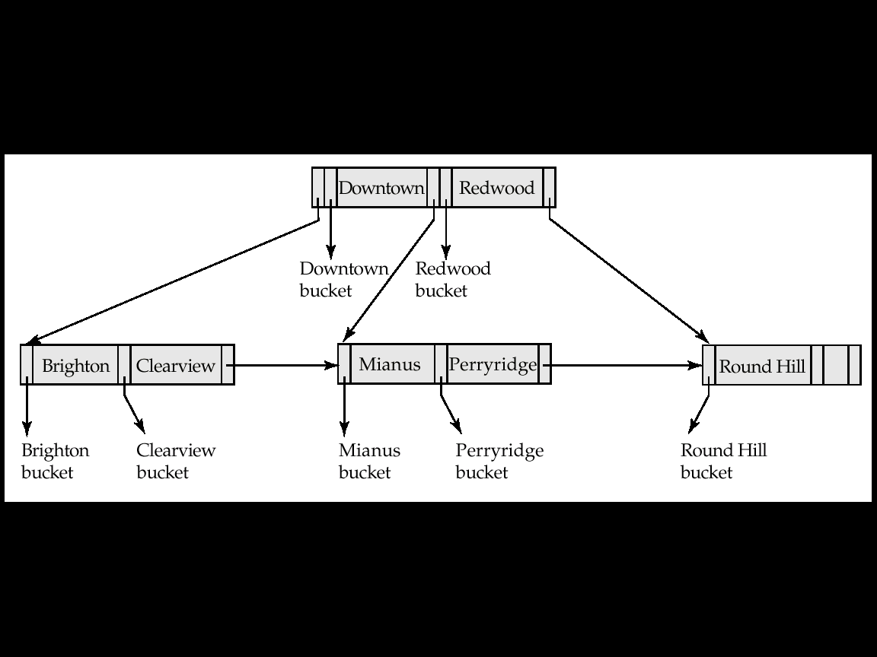
B-Tree Index File Example
B-tree (above) and B+-tree (below) on same data

Slide 61
B-Tree
Construct B-tree of order 3 for following elements
5,10,12,13,14,1,2,3,4
 | 5

Slide 62
B-Tree
Construct B-tree of order 3 for following elements
5,10,12,13,14,1,2,3,4
 | 5 |  | 10
12

Slide 63
B-Tree
Construct B-tree of order 3 for following elements
5,10,12,13,14,1,2,3,4
 | 5 |  | 10
12
 | 10
 | 5
 | 12 |  | 13
14

Slide 64
B-Tree
Construct B-tree of order 3 for following elements
5,10,12,13,14,1,2,3,4
 | 10 |  | 13
 | 5
 | 12
 | 14

Slide 65
B-Tree
Construct B-tree of order 3 for following elements
5,10,12,13,14,1,2,3,4
2
 | 10 |  | 13
 | 1 |  | 5
 | 12
 | 14
2

Slide 66
B-Tree
Construct B-tree of order 3 for following elements
5,10,12,13,14,1,2,3,4
 | 10
 | 2
 | 13
 | 1
 | 5
 | 12
 | 14

Slide 67
B-Tree
Construct B-tree of order 3 for following elements
5,10,12,13,14,1,2,3,4
 | 10
4
 | 2
 | 13
 | 1
 | 3 |  | 5
 | 12
 | 14
4

Slide 68
B-Tree
Construct B-tree of order 3 for following elements
5,10,12,13,14,1,2,3,4
 | 10
 | 2 |  | 4
 | 13
 | 1
 | 3
 | 5
 | 12
 | 14

Slide 69
B-Tree Index Files
Advantages of B-Tree indices:
May use less tree nodes than a corresponding B⁺-Tree.
Sometimes possible to find search-key value before reaching leaf node.
Disadvantages of B-Tree indices:
Only small fraction of all search-key values are found early
Non-leaf nodes are larger, so fan-out is reduced. Thus, B-Trees typically have greater depth than corresponding B⁺-Tree
Insertion and deletion more complicated than in B⁺-Trees
Implementation is harder than B⁺-Trees.
Typically, advantages of B-Trees do not out weigh disadvantages.

Slide 70
B-tree and B+ Tree
B+ Tree
B-tree
Search keys can be repeated
Data is only saved on the leaf nodes.
Data stored on the leaf node makes the search more accurate and faster.
Deletion is not difficult as an element is only removed from a leaf node.
Linked leaf nodes make the search efficient and quick
Search keys cannot be redundant.
Both leaf nodes and internal nodes can store data
Searching is slow due to data stored on Leaf and internal nodes.
Deletion of elements is a complicated and time-consuming process.
You cannot link leaf nodes.

Slide 71
Hashing
In DBMS, hashing is a technique to directly search the location of desired data on the disk without using index structure.
Hashing method is used to index and retrieve items in a database as it is faster to search that specific item using the shorter hashed key instead of using its original value.
Data is stored in the form of data blocks whose address is generated by applying a hash function in the memory location where these records are stored known as a data block or data bucket.

Slide 72
Static Hashing
A bucket is a unit of storage containing one or more records (a bucket is typically a disk block).
In a hash file organization we obtain the bucket of a record directly from its search-key value using a hash function.
Hash function h is a function from the set of all search-key values K to the set of all bucket addresses B.
Hash function is used to locate records for access, insertion as well as deletion.
Records with different search-key values may be mapped to the same bucket; thus entire bucket has to be searched sequentially to locate a record.

Slide 73
Static Hashing
A simple hash function (for N buckets):
h(k) = k MOD N
is bucket # where data entry with key k belongs.
h(key)
0
1
key
h
N-1
Primary bucket pages
Overflow pages

Slide 74
Static Hashing
There are 10 buckets,
The binary representation of the ith character is assumed to be the integer i.
The hash function returns the sum of the binary representations of the characters modulo 10
Therefore buckets range from 0-9
E.g. h(Perryridge) = 5 h(Round Hill) = 3
h(Brighton) = 3 h(Redwood) = 4
h(Mianus) = 7 h(Downtown) = 8

Slide 75
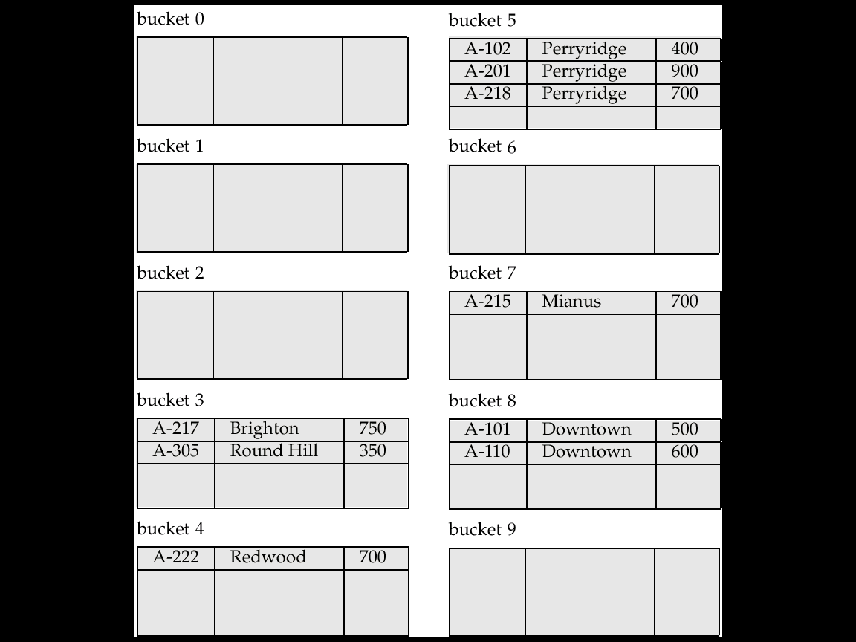
Hash File Organization

Slide 76
Hash Functions
Worst hash function maps all search-key values to the same bucket; this makes access time proportional to the number of search-key values in the file.
An ideal hash function is uniform, i.e., each bucket is assigned the same number of search-key values from the set of all possible values.
Ideal hash function is random, so each bucket will have the same number of records assigned to it irrespective of the actual distribution of search-key values in the file.
Typical hash functions perform computation on the internal binary representation of the search-key.
For example, for a string search-key, the binary representations of all the characters in the string could be added and the sum modulo the number of buckets could be returned. .

Slide 77
Overflow Buckets
Bucket overflow can occur because of
Insufficient buckets
Skew in distribution of records. This can occur due to two reasons:
multiple records have same search-key value
chosen hash function produces non-uniform distribution of key values
Although the probability of bucket overflow can be reduced, it cannot be eliminated; it is handled by using overflow buckets.
Overflow chaining – the overflow buckets of a given bucket are chained together in a linked list called closed hashing.

Slide 78
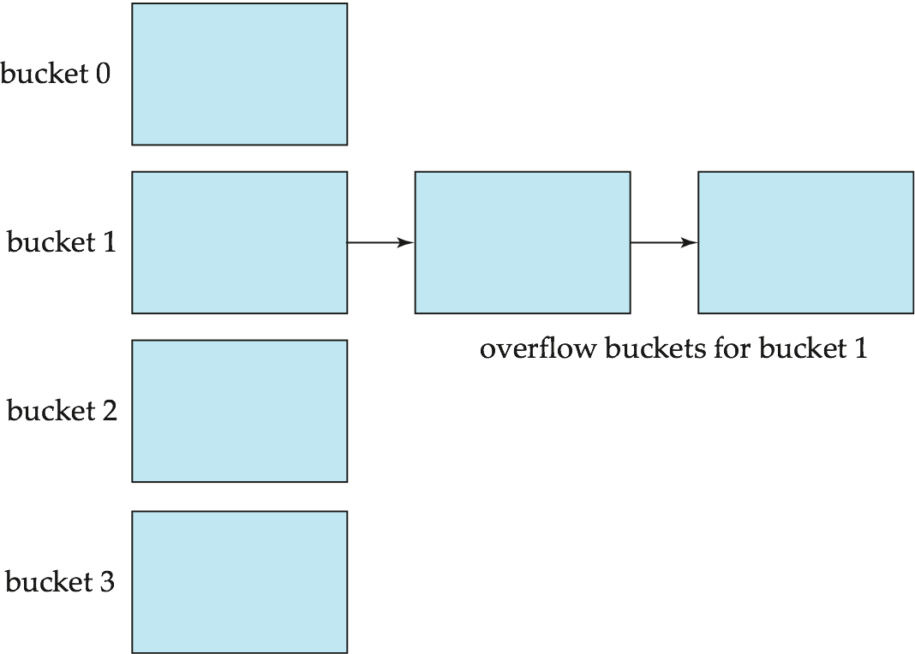
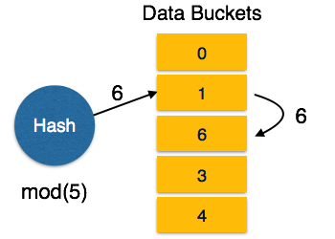
Overflow Buckets
Closed Hashing
Linear Probing − When a hash function generates an address at which data is already stored, the next free bucket is allocated to it. This mechanism is called Open Hashing.
Not suitable for database applications

Slide 79
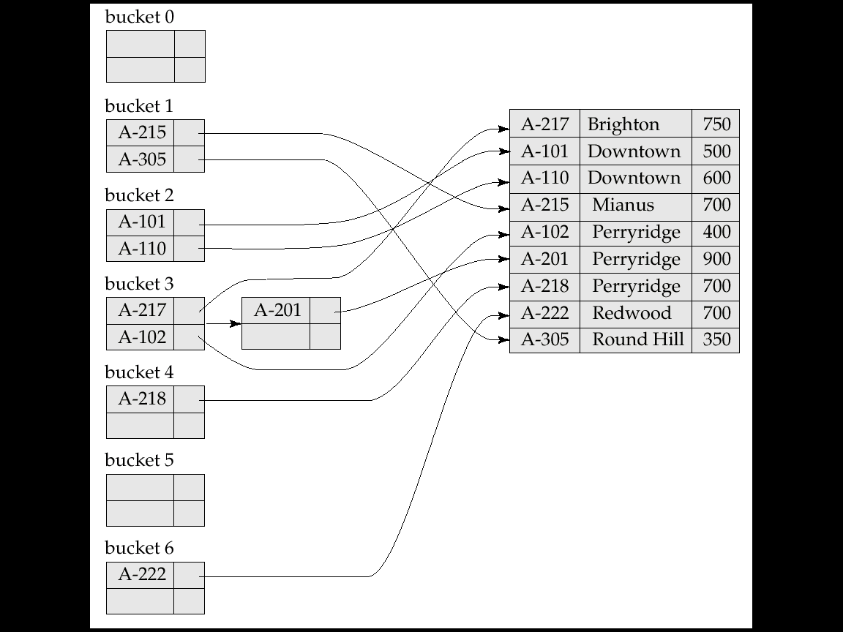
Hash indices
Hashing can be used not only for file organization, but also for index-structure creation.
A hash index organizes the search keys, with their associated record pointers, into a hash file structure.
Strictly speaking, hash indices are always secondary indices
However, we use the term hash index to refer to both secondary index structures and hash organized files.

Slide 80
Deficiencies of Static Hashing
In static hashing, function h maps search-key values to a fixed set of B of bucket addresses. Databases grow or shrink with time.
If initial number of buckets is too small, and file grows, performance will degrade due to too much overflows.
If space is allocated for anticipated growth, a significant amount of space will be wasted initially (and buckets will be underfull).
If database shrinks, again space will be wasted.
One solution: periodic re-organization of the file with a new hash function
Expensive, disrupts normal operations
Better solution: allow the number of buckets to be modified dynamically

Slide 81
Dynamic Hashing
Good for database that grows and shrinks in size
Allows the hash function to be modified dynamically
Extendable hashing – one form of dynamic hashing
Hash function generates values over a large range — typically b-bit integers, with b = 32.
At any time use only a prefix of the hash function to index into a table of bucket addresses.
Let the length of the prefix be i bits, 0 < i < 32.
Bucket address table size = 2i. Initially i = 0
Value of i grows and shrinks as the size of the database grows and shrinks.
Multiple entries in the bucket address table may point to a bucket Thus, actual number of buckets is < 2^{i}
The number of buckets also changes dynamically due to coalescing and splitting of buckets.

Slide 82
Dynamic Hashing Example
Assume seat no. are primary keys and are as below:-
16,4,6,22,24,10,31,7,9,20,26.
Assume Bucket Size = 3
Hash Function: Suppose the global depth is X. Then the Hash Function returns X LSBs.
Soln:- Calculate binary form of each number
16- 10000
4- 00100
6- 00110
22- 10110
24- 11000
10- 01010
31- 11111
7- 00111
9- 01001
20- 10100
26- 01101

Slide 83
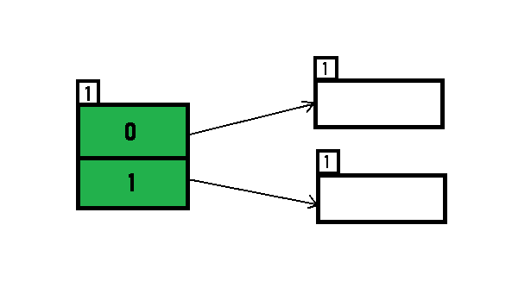
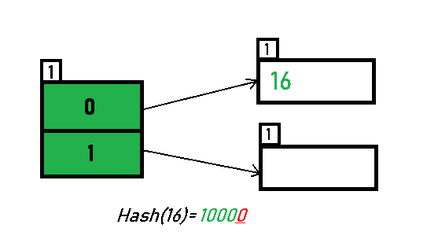
Dynamic Hashing Example
Initially, the global-depth and local-depth is always 1
the directory with id=0.
The binary format of 16 is 10000 and global-depth is 1.
The hash function returns 1 LSB of 10000 which is 0.
Hence, 16 is mapped to the directory with id=0.

Slide 84
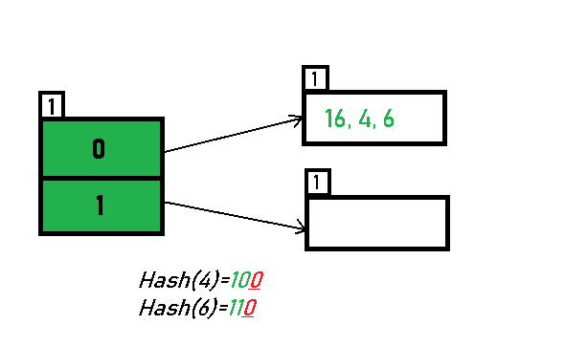
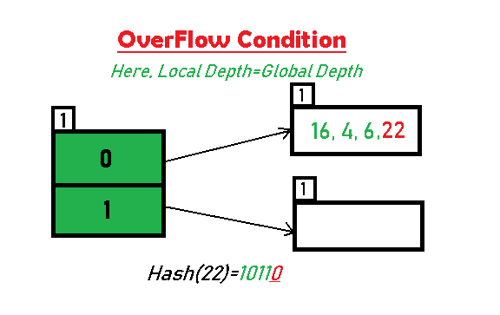
Dynamic Hashing Example
Inserting 4 and 6: Both 4(100) and 6(110)have 0 in their LSB
Inserting 22: The binary form of 22 is 10110. Its LSB is 0. The bucket pointed by directory 0 is already full. Hence, Over Flow occurs.

Slide 85
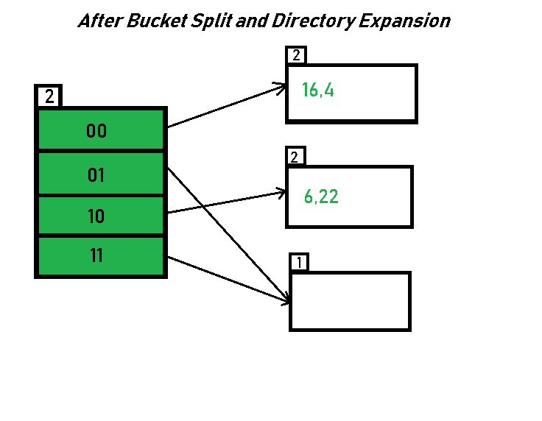
Dynamic Hashing Example
Since Local Depth = Global Depth, the bucket splits and directory expansion takes place.
Also, rehashing of numbers present in the overflowing bucket takes place after the split.
And, since the global depth is incremented by 1, now, the global depth is 2. Hence, 16,4,6,22 are now rehashed w.r.t 2 LSBs.[ 16(10000),4(100),6(110),22(10110) ]
Any bucket having a local depth less than the global depth is pointed-to by more than one directories.

Slide 86
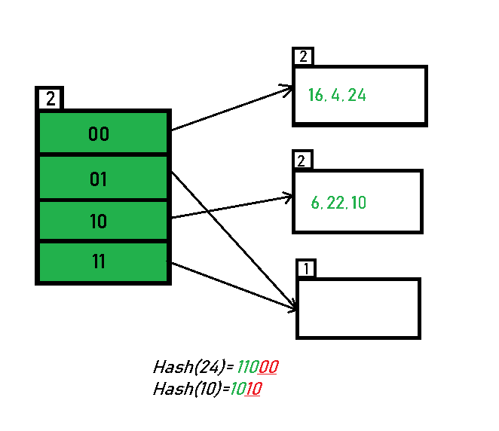
Dynamic Hashing Example
Inserting 24 and 10: 24(11000) and 10 (1010) can be hashed based on directories with id 00 and 10.

Slide 87
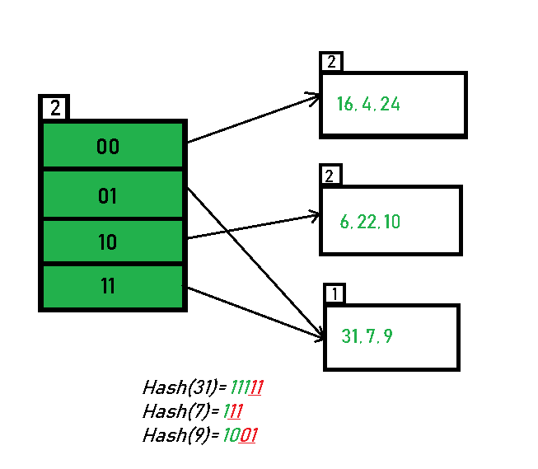
Dynamic Hashing Example
Inserting 31,7,9: All of these elements[ 31(11111), 7(111), 9(1001) ] have either 01 or 11 in their LSBs.

Slide 88
Dynamic Hashing Example
Inserting 20: Insertion of data element 20 (10100)

Slide 89
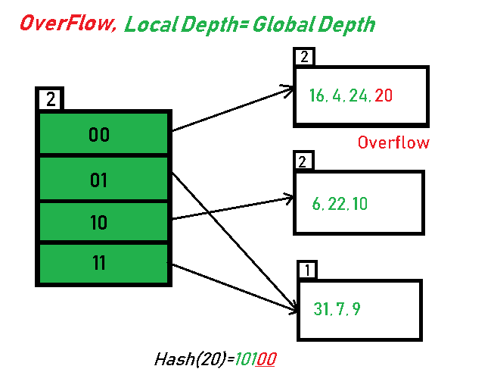
Dynamic Hashing Example
Inserting 20: Insertion of data element 20 (10100)

Slide 90
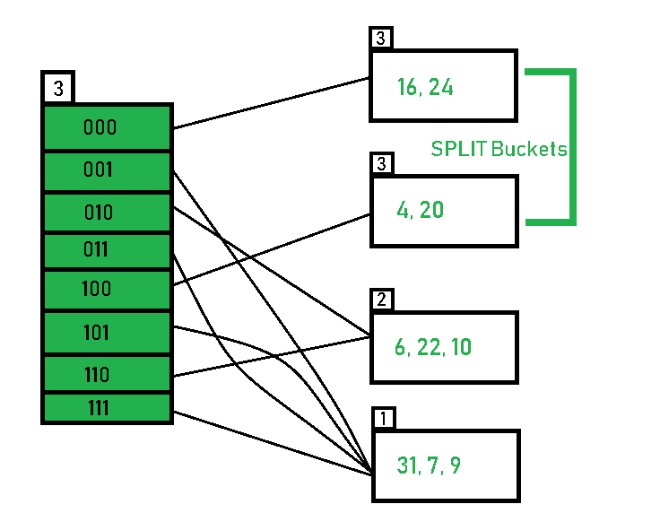
Dynamic Hashing Example
Soln:- directory expansion (doubling) takes place along with bucket splitting. Elements present in overflowing bucket are rehashed with the new global depth

Slide 91
Extendable Hashing
Benefits of extendable hashing:
Hash performance does not degrade with growth of file
Minimal space overhead
Disadvantages of extendable hashing
Extra level of indirection to find desired record
Bucket address table may itself become very big (larger than memory)
Need a tree structure to locate desired record in the structure!
Changing size of bucket address table is an expensive operation
Linear hashing is an alternative mechanism which avoids these disadvantages at the possible cost of more bucket overflows

Slide 92
Indexing Technique
What indexing technique can we use to support range searches (e.g., “Find s_name where gpa >= 3.0)?
Tree-Based Indexing
What about equality selections (e.g., “Find s_name where sid = 102”?
Tree-Based Indexing
Hash-Based Indexing (cannot support range searches!)
Hash-based indexing, however, proves to be very useful in implementing relational operators (e.g., joins)

